Slide 1
Project Based Learning -III
StartUp Alchemy: Turning Data into Success Spells
Team Details:
Ayush Bansal (2210993778)
Manya Saini (2210993814)
Virender Garg (2210993861)
Faculty Coordinator:
Dr. Kanika
Dr. Tanvi Sood
:
Chitkara University Institute of Engineering and Technology,
Chitkara University, Punjab

Slide 2
Table of Contents
Introduction
Problem Statement
Technical Details
Flow Chart
Key Features
Project Highlights
Bonus Feature
Conclusion
References/Links used

Slide 3
Introduction
In the challenging landscape of startups, where success remains elusive, "Startup Alchemy: Turning Data into Success Spells" ventures into the uncharted territory of deciphering the secrets of triumph. This project explores the startup realm, deploying data-driven decision-making, machine learning, and visualization to predict success. Focused on healthcare AI startups, the project aims to uncover key insights that empower emerging ventures in this dynamic sector.

Slide 4
Problem Statement
"In the dynamic startup landscape, especially within healthcare AI, the challenge lies in accurately predicting success. Many startups lack a reliable framework for evaluation. This project addresses the issue, utilizing advanced data analysis and machine learning to create a tailored predictive model. Our goal is to provide healthcare AI startups with essential insights for navigating the competitive landscape and achieving success."

Slide 5




Technical Details
Python, a versatile and robust programming language, serves as the backbone of our analysis and modeling efforts. Using Jupiter Notebook and leveraging Python’s data science libraries, such as Pandas and Numpy, we perform in-depth data analysis and build predictive models. For visualization, Matplotlib enable us to create informative and visually compelling representations of our findings.
Microsoft Excel plays a pivotal role in curating and structuring our dataset, ensuring its quality and reliability.
Visual Studio Code provides basic support for python programming out of the box. There is syntax highlighting, smart completions with IntelliSense, and customizable formatting.
HTML, CSS and JavaScript provides as s basic web development tool for the development of the website for our project. JavaScript mainly being the most important tool for charts and map visualizations on the trained models

Slide 6
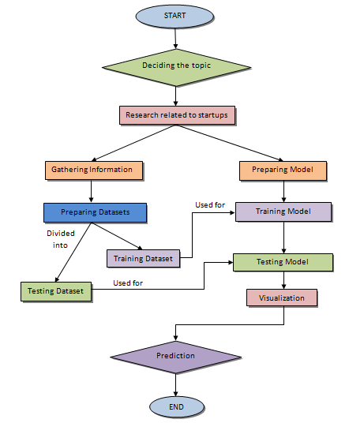
FLOWCHART

Slide 7
Key Features
Custom Dataset Creation
A bespoke dataset is meticulously crafted capturing essential features.
Visualization for Feature Selection
The visualizations exploring relationships between variables guide the selection of features for model training.
Mutli-Model Approach
Choice of three models for prediction analysis.
State-Level Analysis
Unlike many other prediction models, our project provides a granular state-level analysis.
Web-based Interface:
The project offers a user-friendly web interface for selecting models, inputting parameters, and visualizing results.
Business Insights:
Our project aims to provide valuable business insights bt identifying factors contributing to startup success.

Slide 8
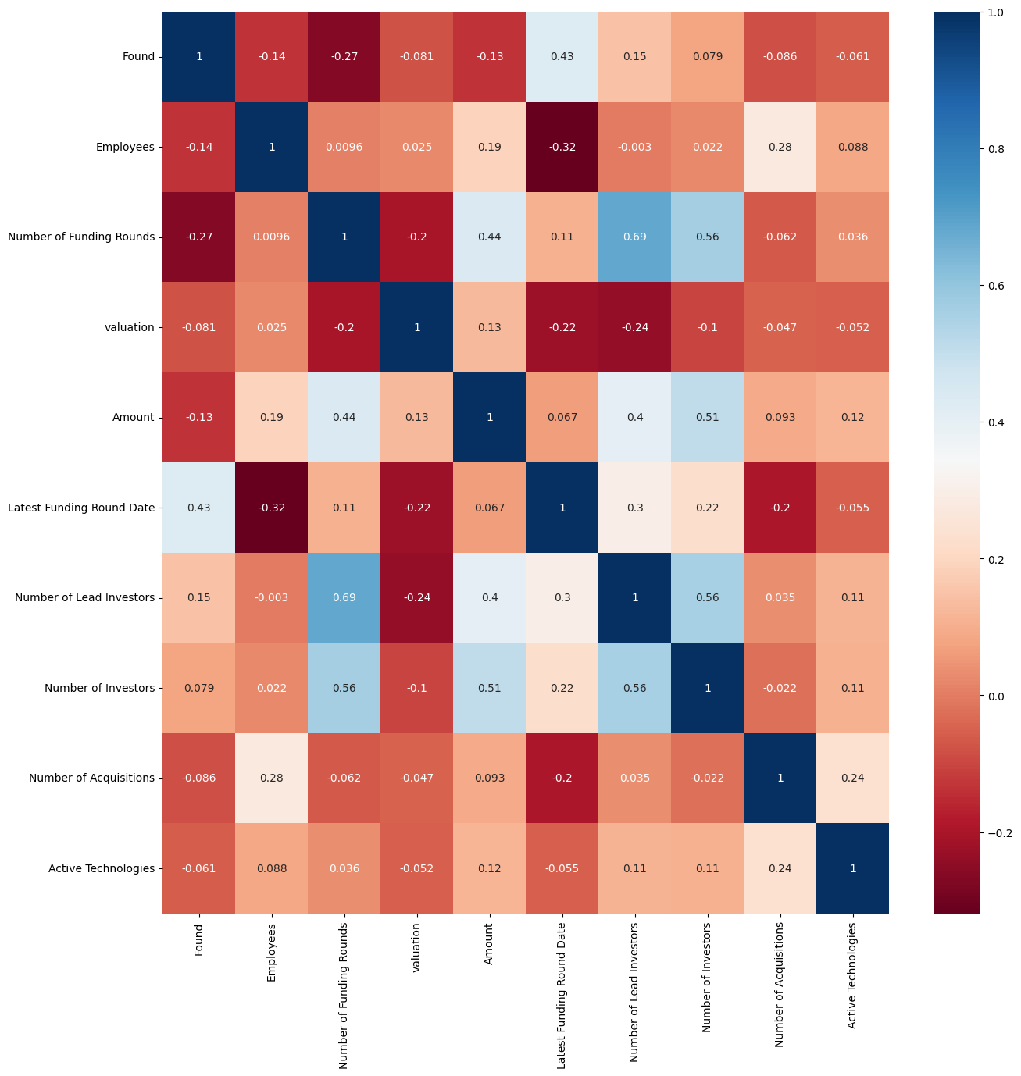
Project Highlights
Correlation of Success with various features

Slide 9
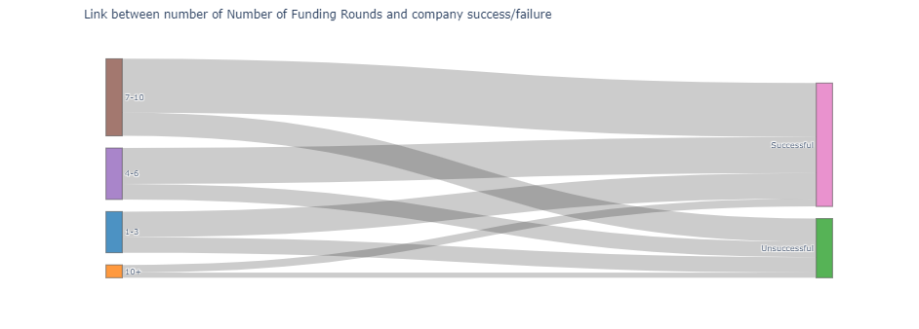
Project Highlights
Funding Rounding → Success relation
Sankey plot 1

Slide 10
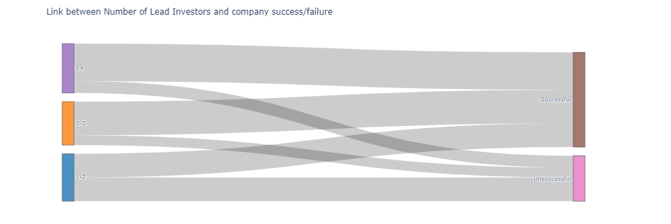
Project Highlights
Lead Investors → Success relation
Sankey plot 2

Slide 11
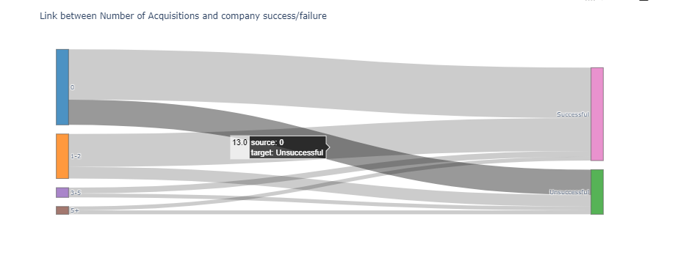
Project Highlights
No. of acquisitions → Success relation
Sankey plot 3

Slide 12
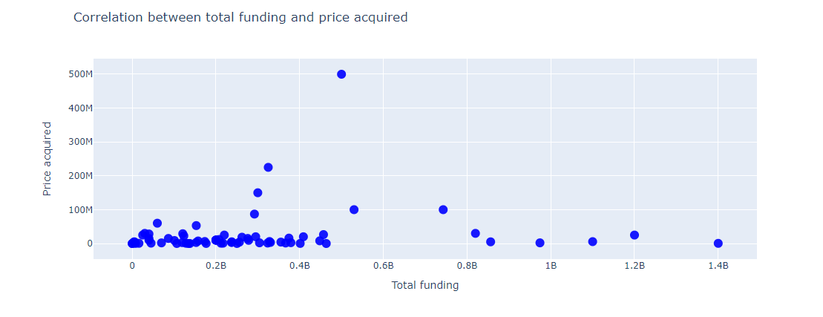
Project Highlights
Scatter Plot between PRICE ACQUIRED & TOTAL FUNDING received

Slide 13
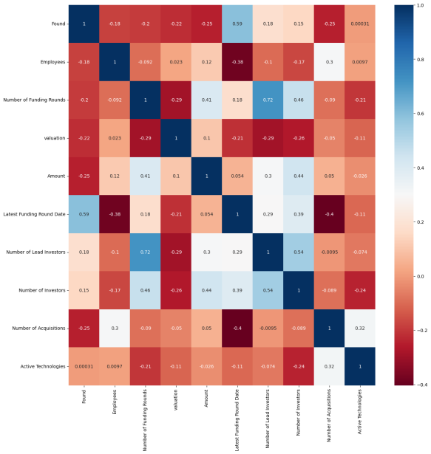
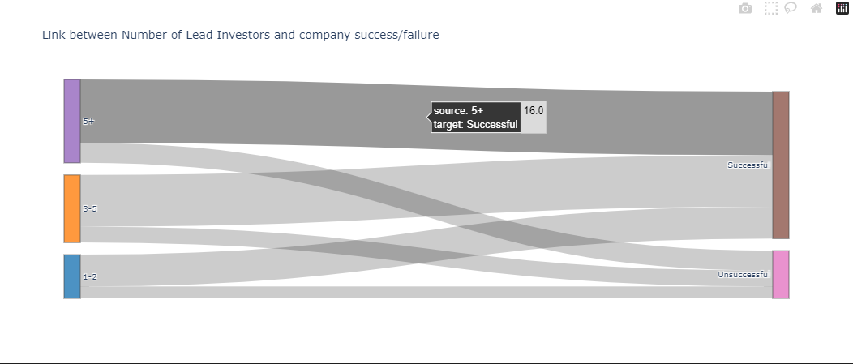
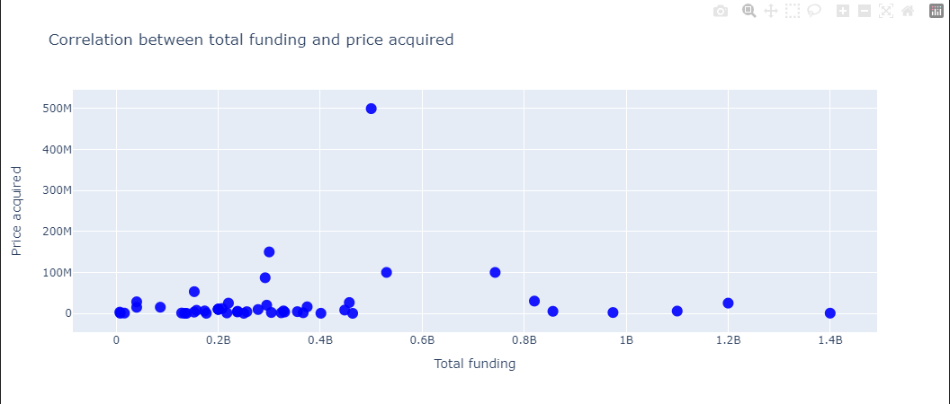
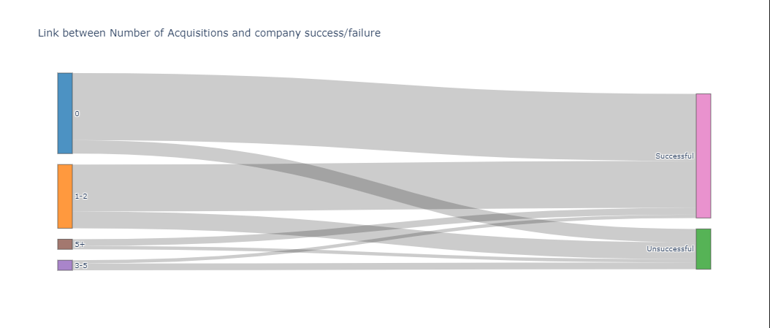
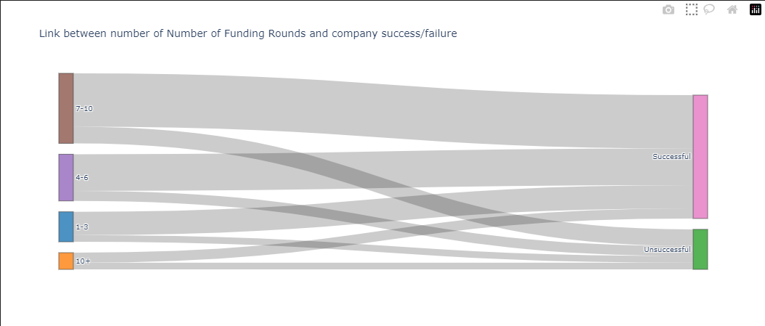
Project Highlights
Significance
We are identifying the top correlated features and grouping them into different ranges, to explore the relationship between features in each group to their labels. We are visually discovering the strong correlation between the feature and labels.

Slide 14
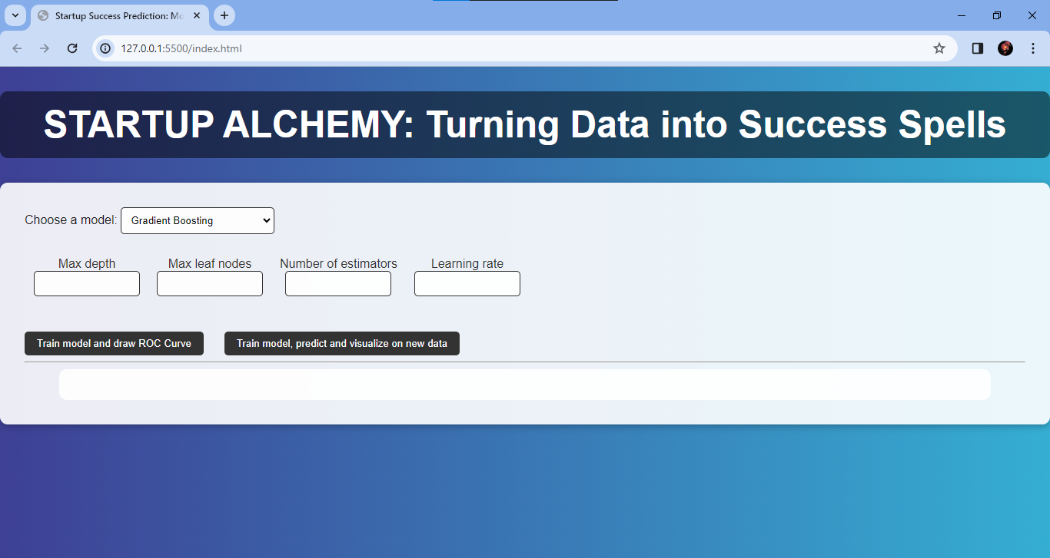
Project Highlights
Our Website

Slide 15
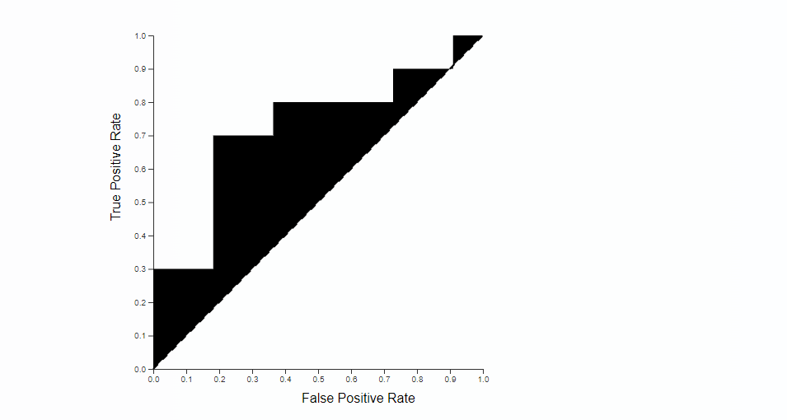
Project Highlights
Visualization of ROC Curve
ROC curve for gradient boosting Algorithm

Slide 16
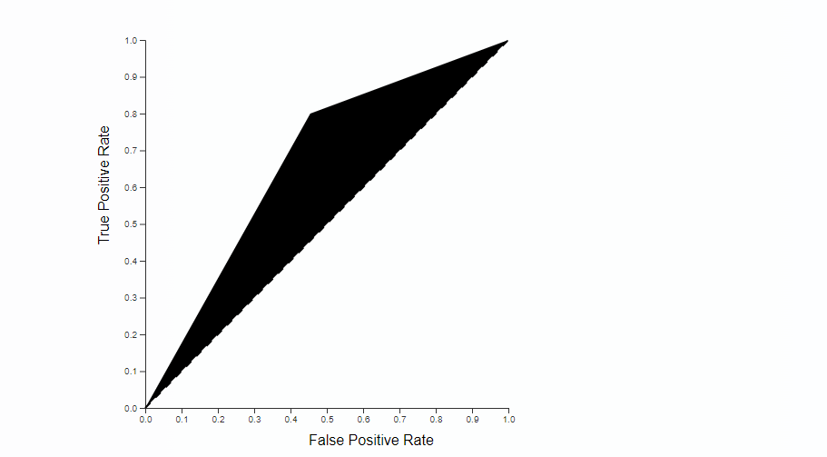
Project Highlights
Visualization of ROC Curve
ROC curve for decision trees Algorithm

Slide 17
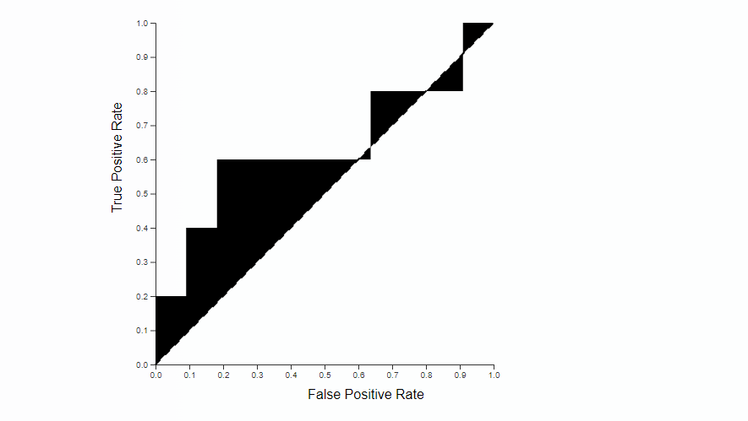
Project Highlights
Visualization of ROC Curve
ROC curve for Random forests Algorithm

Slide 18
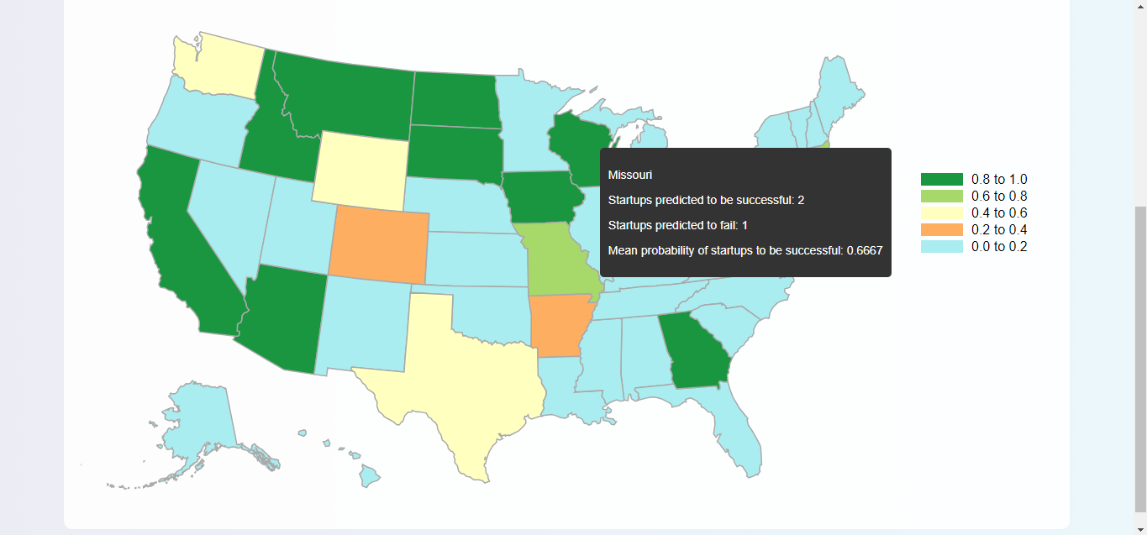
Project Highlights
Geospatial Visualization
For gradient Boosting Algorithm

Slide 19
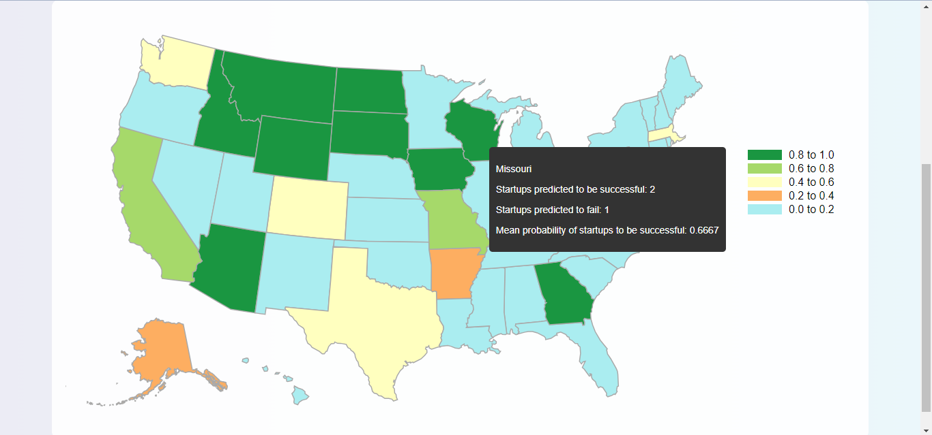
Project Highlights
Geospatial Visualization
For decision trees Algorithm

Slide 20
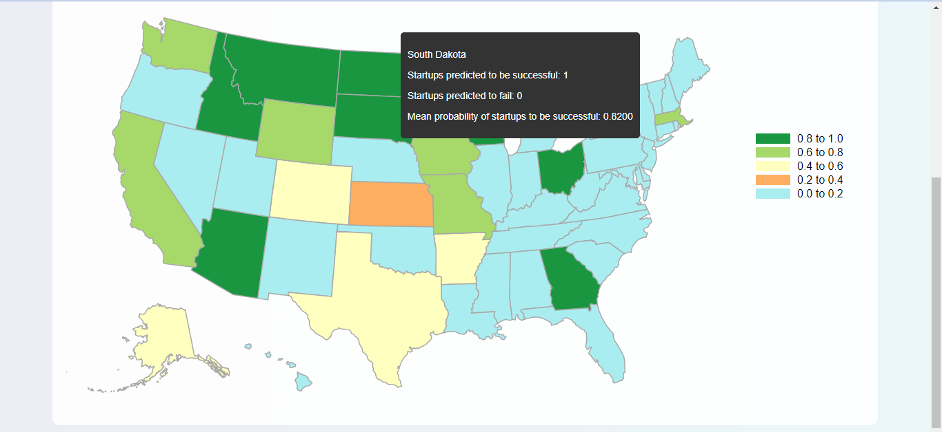
Project Highlights
Geospatial Visualization
For random forests Algorithm

Slide 21
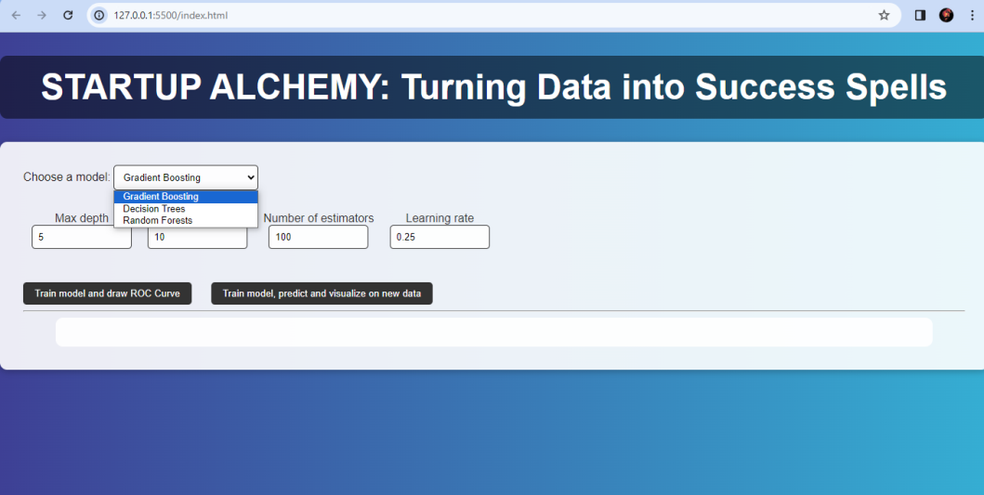

Bonus Features
Multi-Model Approach: The project employs three distinct machine learning models—Gradient Boosting, Random Forest, and Decision Tree Classifier—providing a comprehensive understanding of startup prediction.
State-Level Analysis: Unlike many other prediction models, our project provides a granular state-level analysis.
Multi-Model approach
State-level analysis

Slide 22
Future Scope
The future trajectory of "Startup Alchemy" envisions an iterative process of model refinement, embracing real-time data feeds, and expanding predictive capacities to encompass diverse sectors beyond healthcare AI. By fostering ongoing collaboration and staying agile, the project aims to remain at the forefront of startup success prediction, providing valuable insights and strategic guidance for entrepreneurs and investors alike.

Slide 23

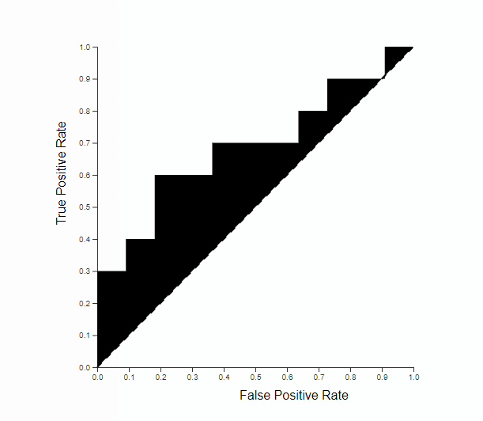

Conclusion
In conclusion, our project pioneers a predictive model for success in healthcare AI startups, blending data analytics, machine learning, and advanced visualization. With a multi-model approach and user-friendly interface, it provides vital insights to navigate the unpredictable startup landscape.

Slide 24
References/Links used
“Predicting Startup Success Using Publicly Available Data”
by Emily Gavrilenko, A Thesis presented to the Faculty of California Polytechnic State University, San Luis Obuspo.
“Predicting the outcome of startups: less failure, more success”
by Krishna, A., Agrawal, A., & Choudhary, A. (2016 December)
Crunchbase:
https://www.crunchbase.com/
AI Startups
https://www.medicalstartups.org/top/ai/
GitHub
It is useful for getting inspiration Link- https://github.com/.

Slide 25


